Slide 1
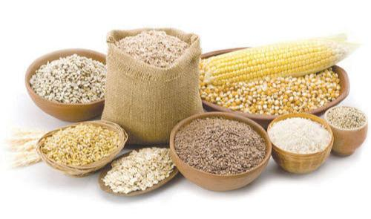
Price Trends of some Staple foods in Nigeria (January – November 2023)

Slide 2
Introduction
Staple foods are foods that makes up the dominant part of a population’s diet.
In Nigeria, some of those staple foods include:
Bread
Rice
Garri
Cassava Meals
Groundnuts
Maize

Slide 3
Introduction cont'd
In this project, we delved into analyzing
Monthly price trends of these foods from Jan-Nov 2023
Inflation rate
Causes of inflation
Dataset:
https://microdata.worldbank.org/index.php/catalog/4503

Slide 4
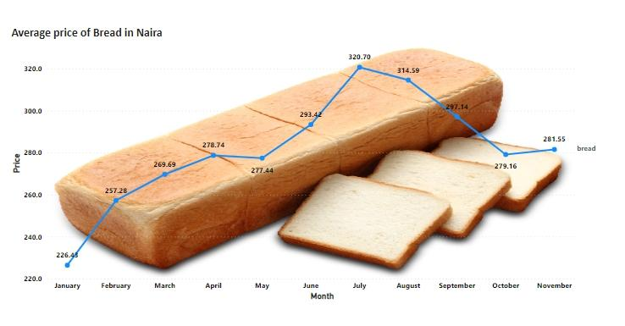
Bread
Lowest price
Month – January
Price – N226.43
Highest price
Month – July
Price – N320.70
Inflation rate (Jan-Nov)
24.34%

Slide 5
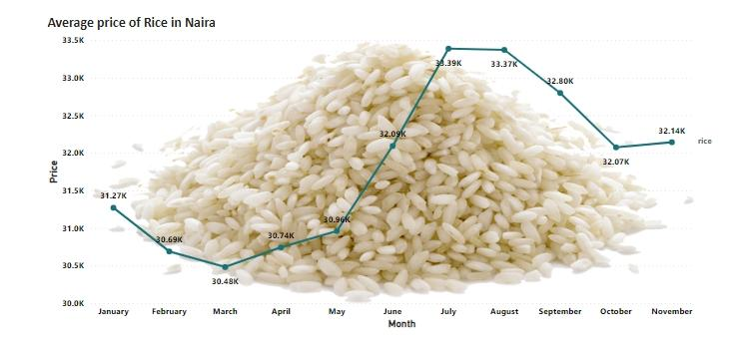
Rice
Lowest price(per bag)
Month – March
Price – N30,481.56
Highest price(per bag)
Month – July
Price – N33,388.71
Inflation rate (Jan-Nov)
2.79%

Slide 6
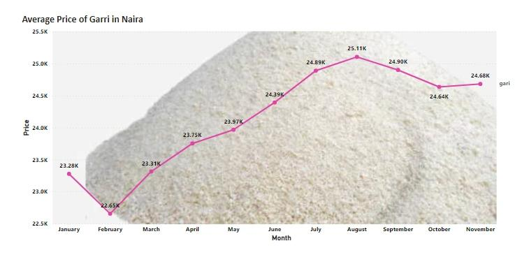
Garri
Lowest price(per bag)
Month – February
Price – N22,654.75
Highest price (per bag)
Month – August
Price – N25,105.76
Inflation rate(Jan-Nov)
6.03%

Slide 7
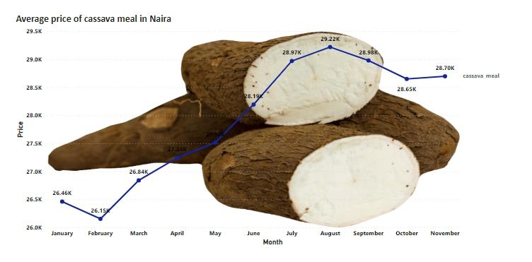
Cassava Meals
Lowest price (per bag)
Month – February
Price – N26,153.98
Highest price (per bag)
Month – August
Price – N29,219.92
Inflation rate (Jan-Nov)
8.44%

Slide 8
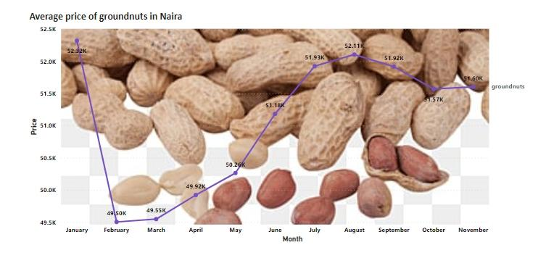
Groundnuts
Lowest price (per bag)
Month – February
Price – N49,503.06
Highest price (per bag)
Month – January
Price – N52,321.14

Slide 9
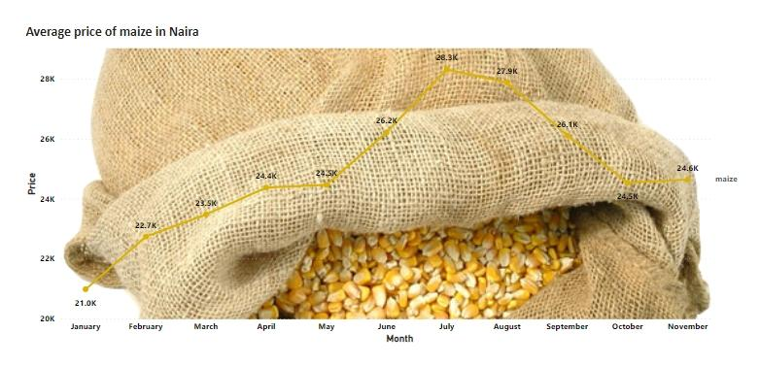
Maize
Lowest price (per bag)
Month – January
Price – N20, 979.37
Highest price (per bag)
Month – July
Price – N28,316.67
Inflation rate (Jan-Nov)
17.43%

Slide 10
Insights
The months of June, July and August seems to be the toughest months for Nigerians this year
Inflation hits the food market especially in the month of July.
This inflation was caused by naira depreciation which occurred around June to July resulting in high prices of food commodities in the markets.
These prices were compiled by the world bank data, which means it is an estimate made in the global market Not exactly the same prices in the local markets.

Slide 11
Thank you

